Slide 1
Computer Science GCSE Week 2 : Introduction
learn how to code so we can pass a paper GCSE exam
exam without computer will be OK
learning without computer not OK
will put our code onto computer in cloud
if instructions are valid ? -> we’ll see what comes out of the box
if instructions aren’t valid ? -> build error tells us where the mistake is
see what’s happening inside the box
• importance of learning code interactively
learn how to code so we can pass a paper GCSE exam
exam without computer will be OK
learning without computer not OK
will put our code onto computer in cloud
• minimum interactivity : building and running
if instructions are valid ? -> we’ll see what comes out of the box
if instructions aren’t valid ? -> build error tells us where the mistake is
• extra interactivity : debugging
see what’s happening inside the box
• detailed look at building and running

Slide 2

Computer Science GCSE Week 2 : detail of building and running
Dim animals as string() = {“cat”, “dog”,
011011010001010100110110101000
Dim animals As string() = {“cat”, “dog”,
Build
Run
“Program.vb”
“Program.exe”
or
“Program.dll”
a text file : human-readable but
not runnable by the microprocessor
a binary file : not human-readable but
runnable by the microprocessor
see what comes
out of the box

Slide 3
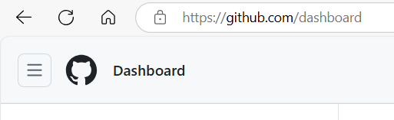
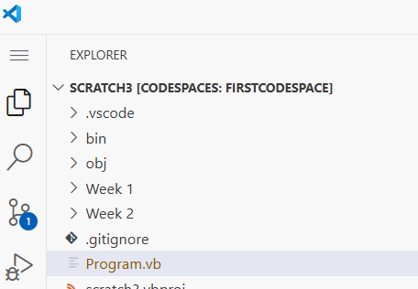
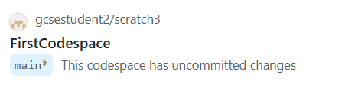
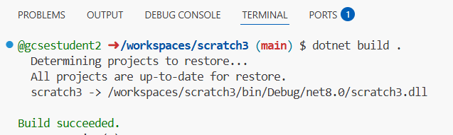
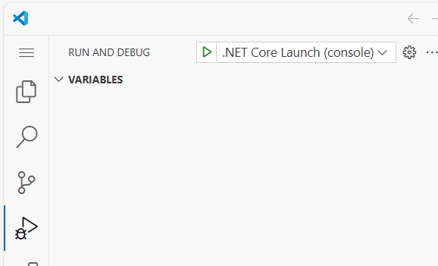
Computer Science GCSE Week 2 : Instructions for Debugging
log into github with username "gcsestudent2“
using hamburger menu at top left of screen, select "codespaces"
at bottom of screen click on "FirstCodespace"
wait upto a minute or so for the codespace to open
at top left of screen click on the pair of squares to open the "Explorer" pane
click on the "Program.vb" file to open it at the top right of the screen
put the code you want to try out in between the lines Sub Main ....... End Sub
at bottom of screen click on the 4th tab called "TERMINAL"
type command "dotnet build ." after the $ symbol to start the build process
if your code is OK you'll see "Build succeeded" in green and "0 Errors"
if your code is not OK you'll see "n Errors" in red text underneath an explanation of what it didn't like
if the build succeeded then on the left of the screen ..
.. click on the triangle with the little bug crawling across it to open the RUN AND DEBUG pane
click on the little green triangle next to the text ".NET Core Launch (console)"

